Slide 1
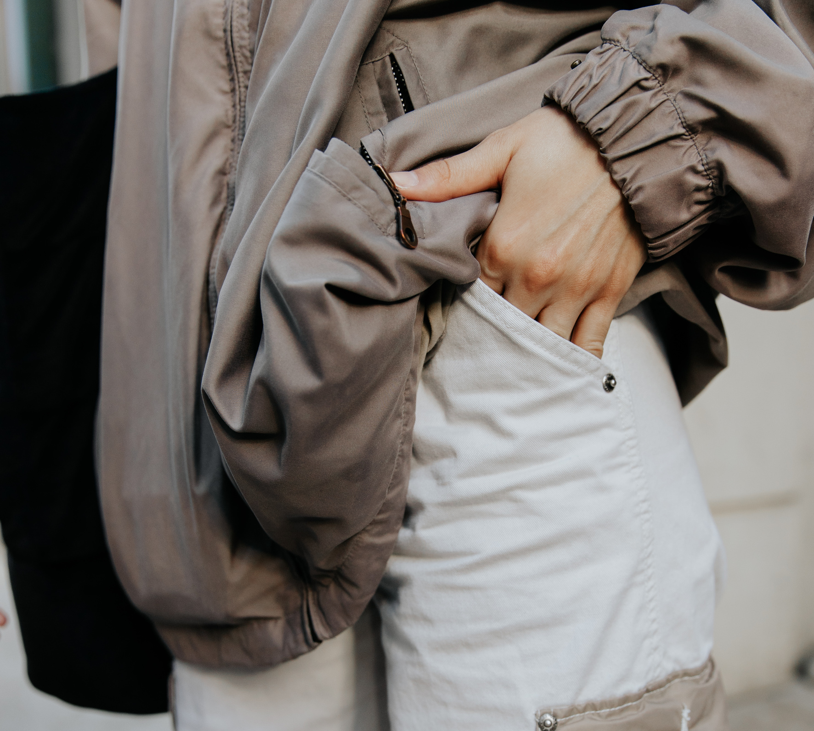
VogueVista
A Fashion
website
Ayesha Chaudhary 24F-0621
Qandeela Azhar 24F-3007
Hanan Mushtaq 24F-0814

Slide 2
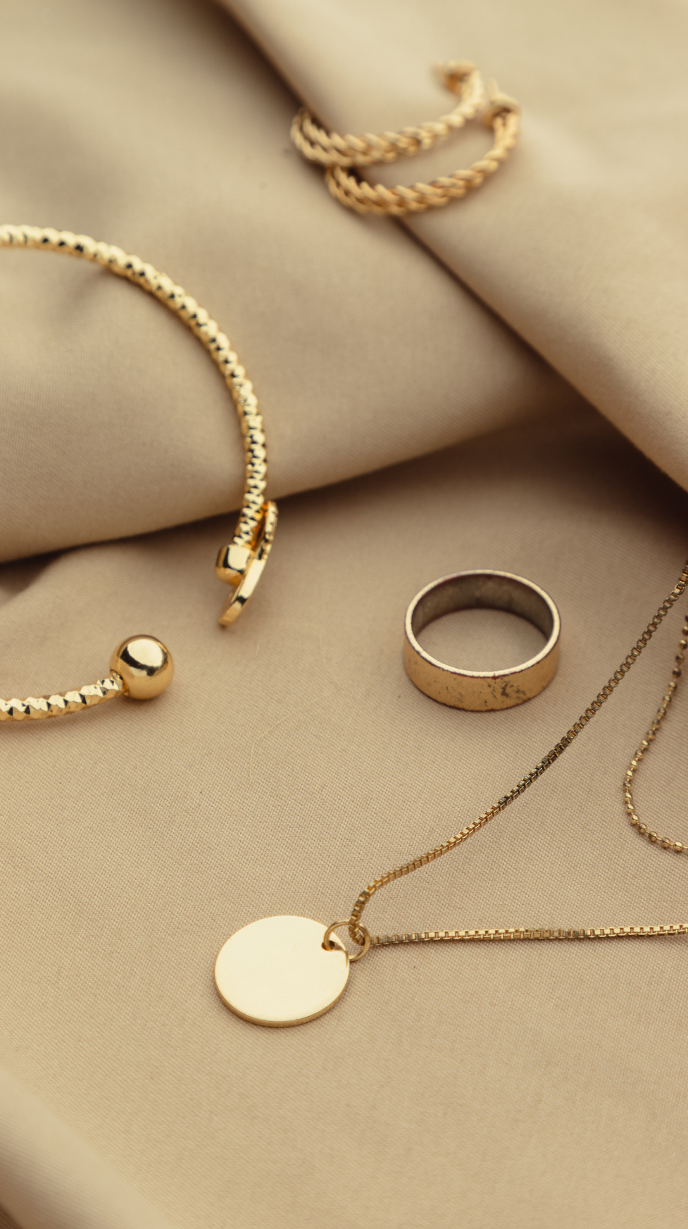
SECTIONS
01
HOME
05
ACCESSORIES
02
MEN
06
ABOUT
03
WOMEN
04
KIDS
VogueVista

Slide 3
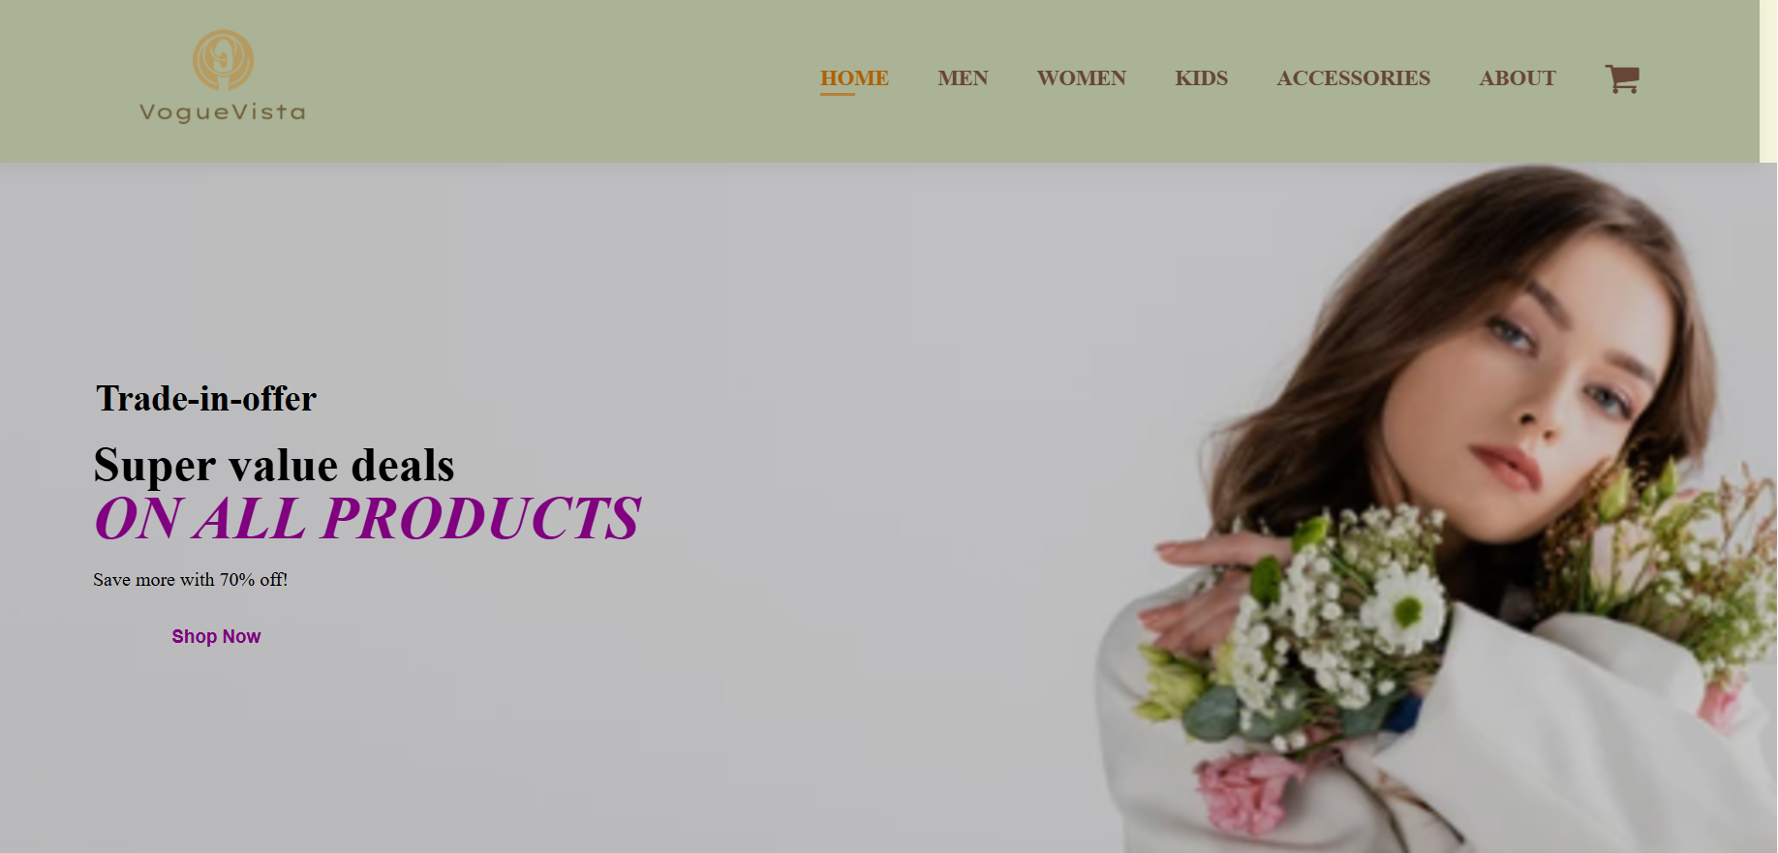
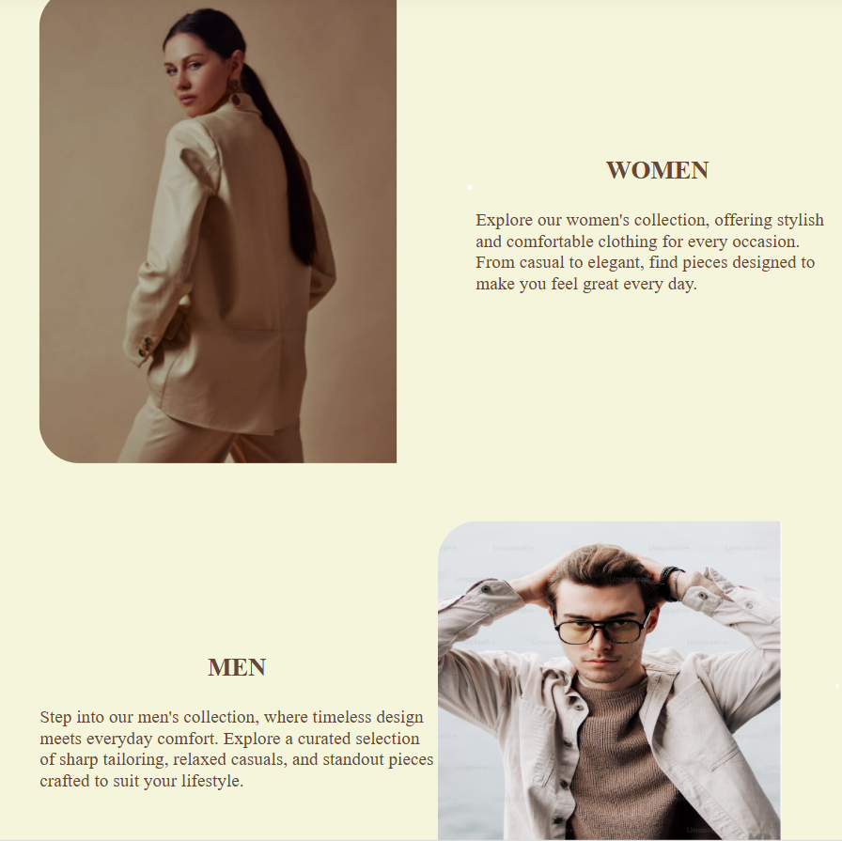
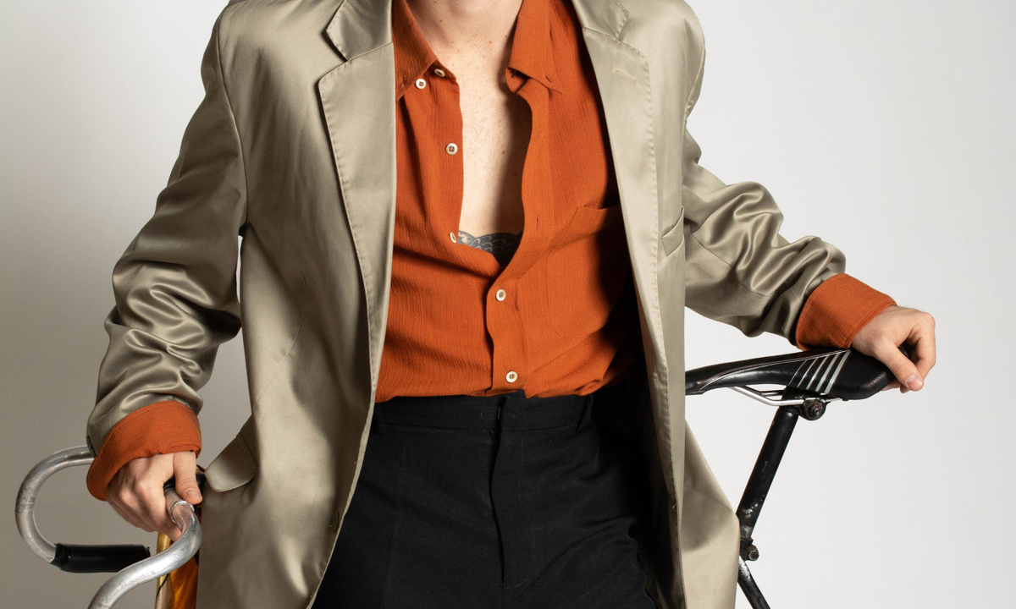
HOME
Home page contains the links and description of other sections with pictures in the middle.
VogueVista

Slide 4
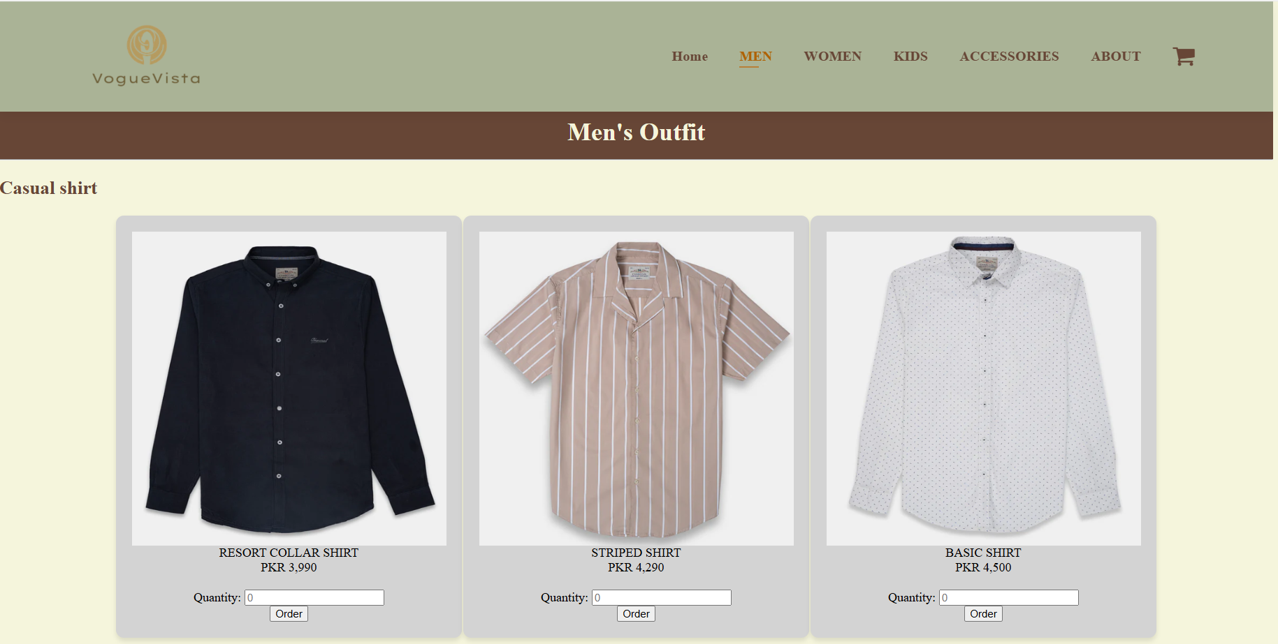
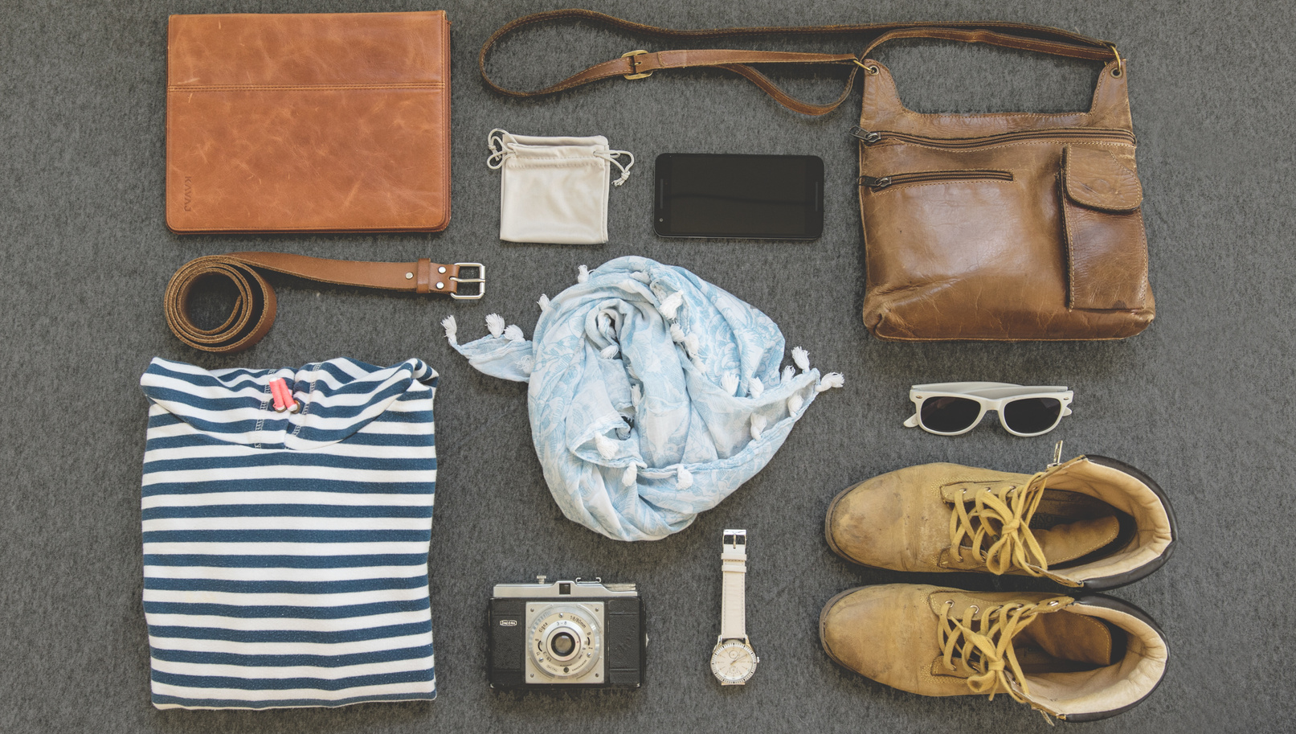
MEN
Applied js on the total bill.
About us information on the last of every page
01
Casual shirts
02
Sweat shirts
03
Hoodies
04
Pants

Slide 5
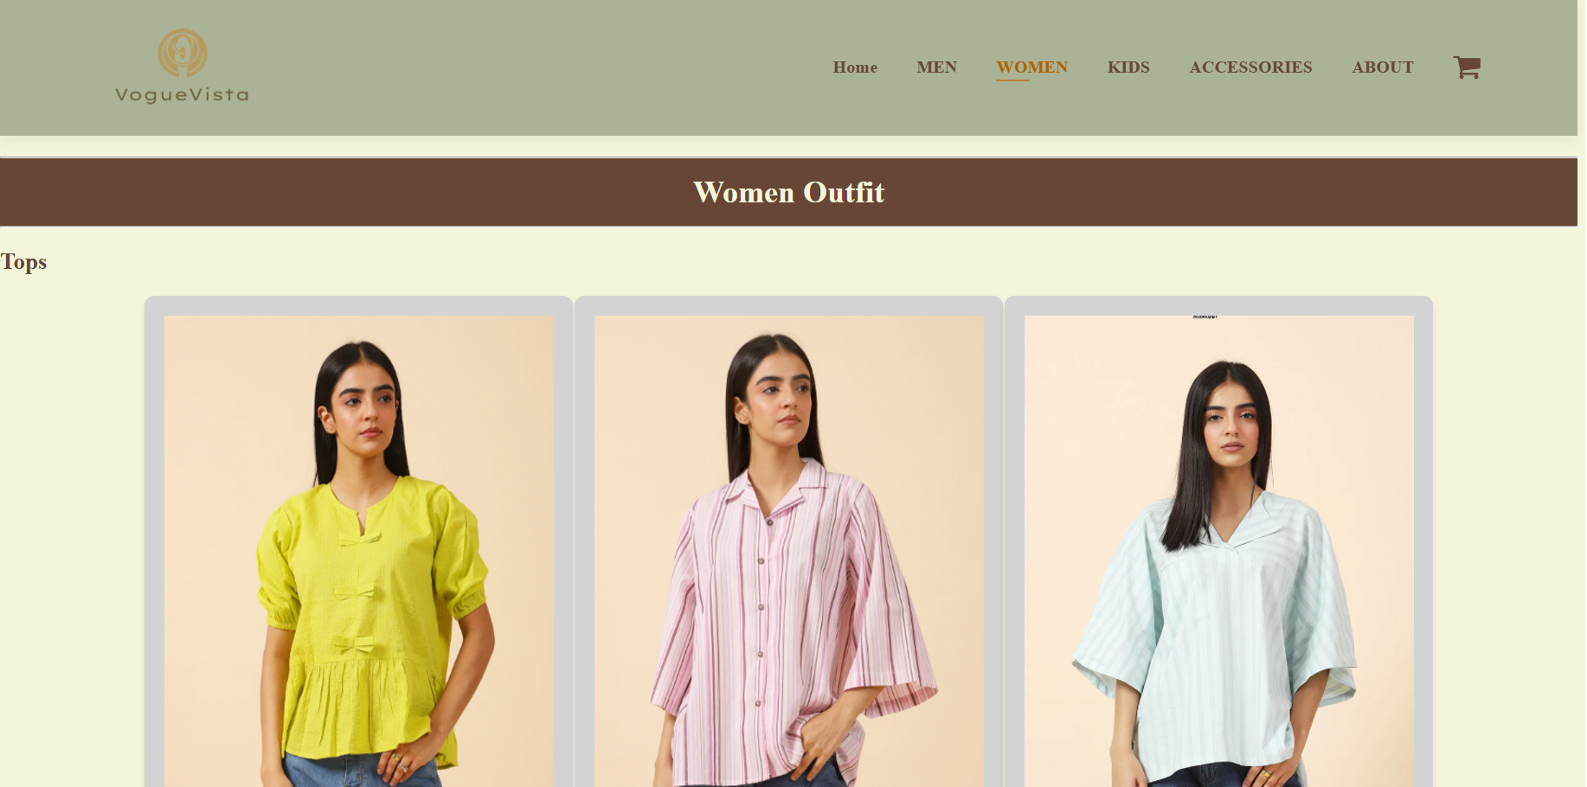
FEMALE
01
Tops
02
Jeans
03
Hoodies
04
Shawl

Slide 6
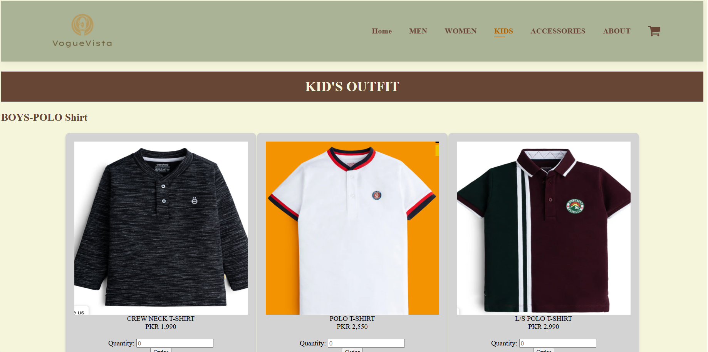
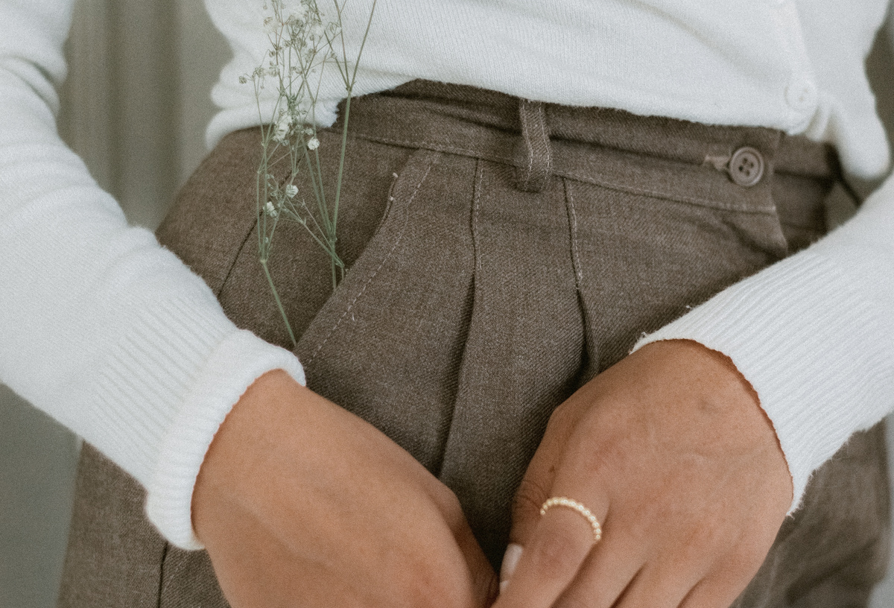
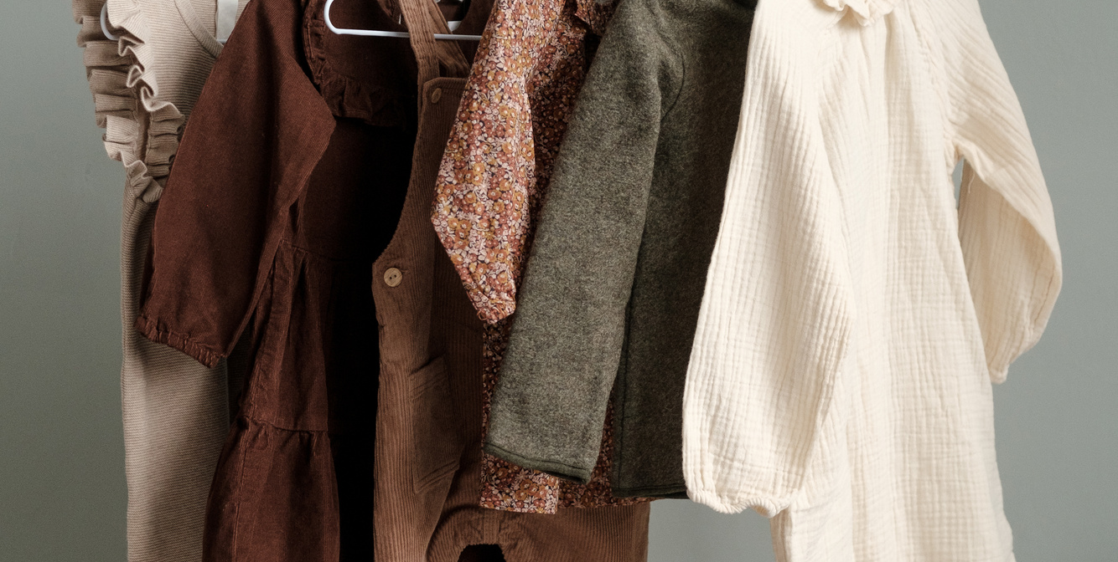
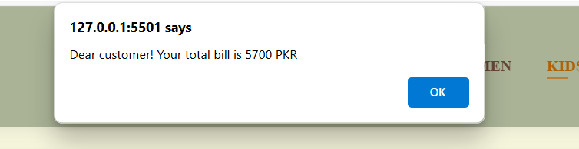
KIDS
Polo shirts
Boys hoodies
Girls jumpsuits
Girls sweat shirts
Java script applied on total bill.

Slide 7
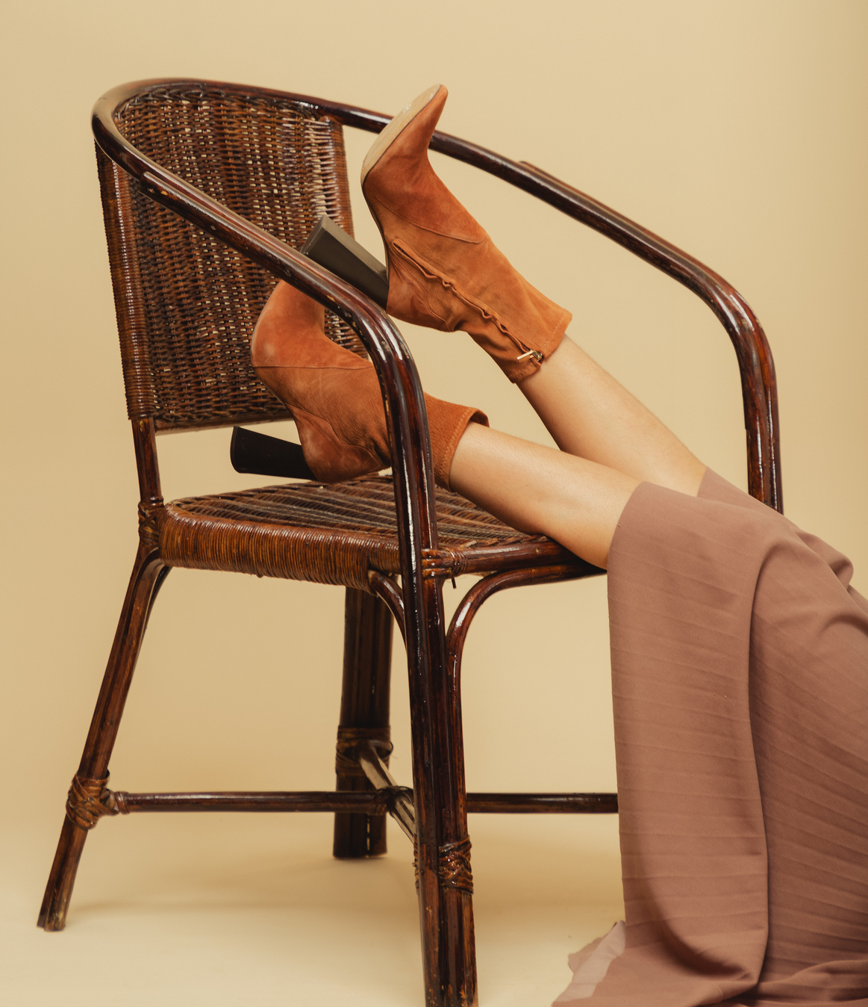
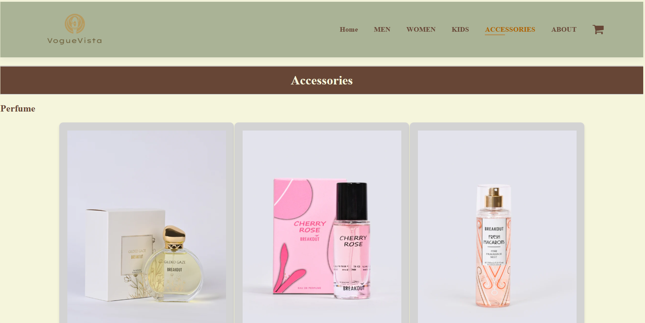
ACCESSORIES
01
Perfume
02
Wallets
03
Women’s bags
04
Caps

Slide 8
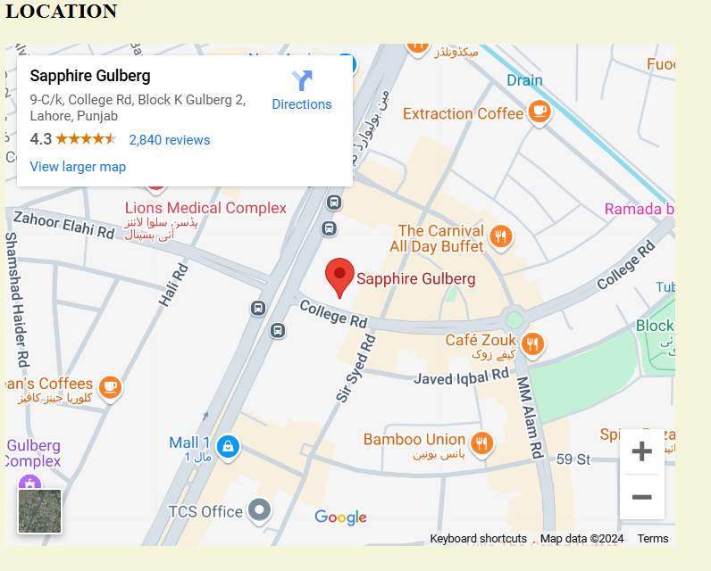
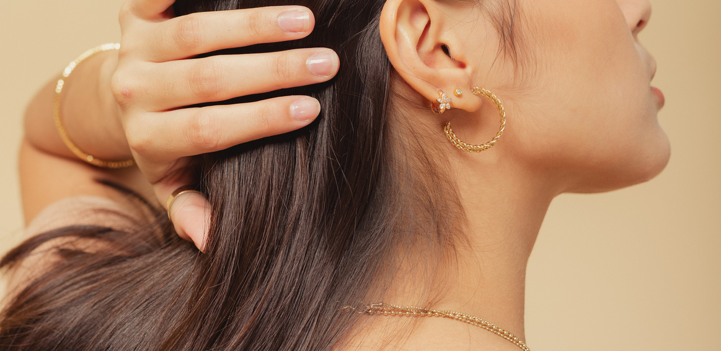
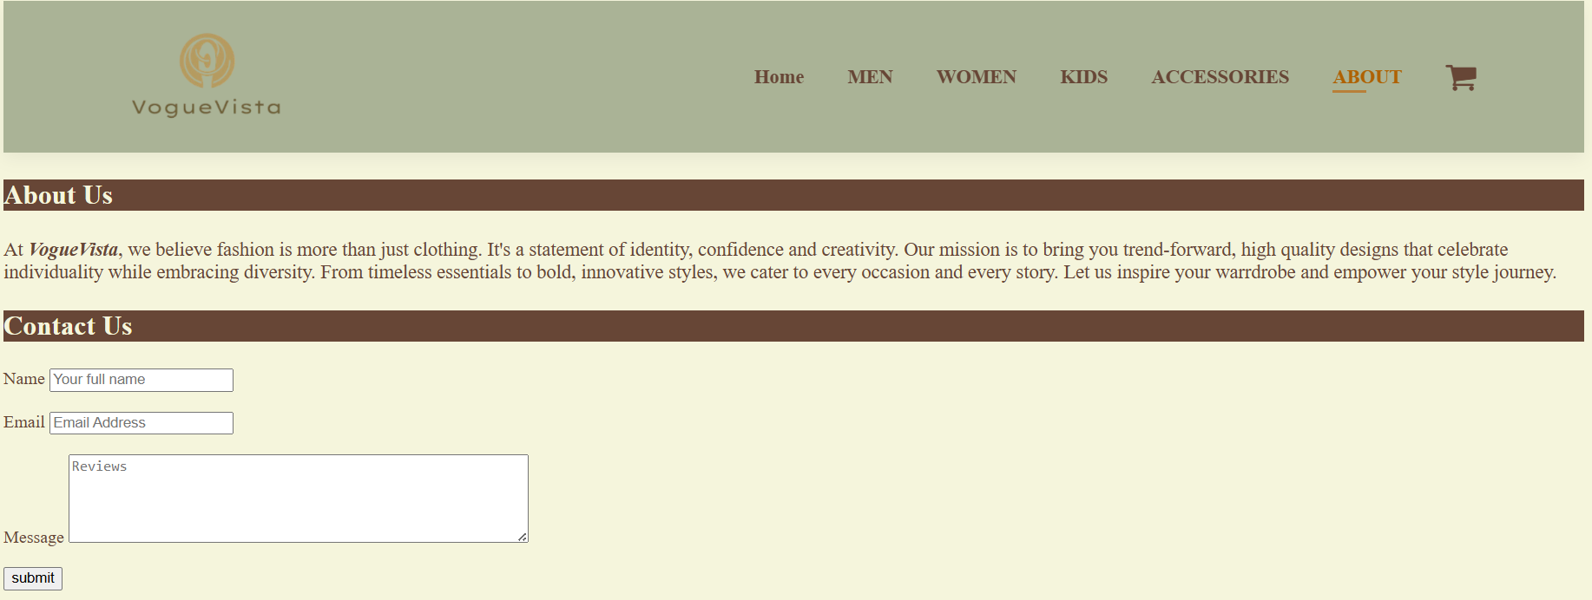
ABOUT US
01
About store
03
Location
02
Feedback
04
Phone, address, email
VogueVista

Slide 9
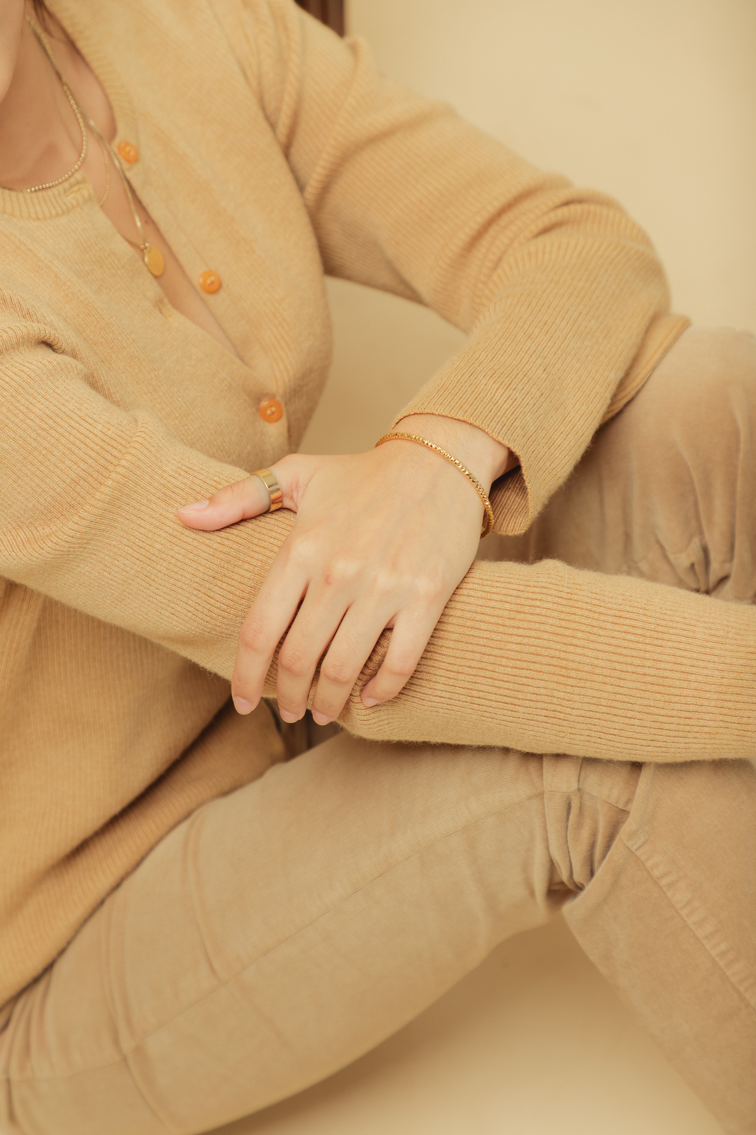
THANK YOU

